Slide 1
LECTURE 1
CERAMIC- FOURTH CLASS
Ceramics are compounds between
metallic and nonmetallic elements; they are most frequently oxides, nitrides, and carbides. For example, some of the common ceramic materials include aluminum oxide (or alumina, Al2O3), silicon dioxide (or silica, SiO2), silicon carbide (SiC) and silicon nitride (Si3N4) in addition to traditional ceramics— those composed of clay minerals (i.e.

Slide 2
porcelain), as well as cement, and glass.
CERAMIC- FOURTH CLASS
Today ceramic may be defined as a
product manufactured by the heat treatment of a material (or mixture of materials) which is inorganic and non- metallic.
Types and Applications of Ceramics
Ceramics can be classified according to their applications as follows:

Slide 3

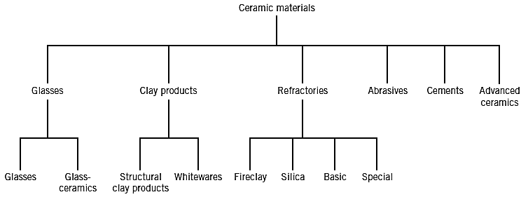
CERAMIC- FOURTH CLASS
GLASSES
Glasses are a familiar group of ceramics;
containers and lenses represent their typical applications. They are
noncrystalline silicates containing other oxides, particularly CaO, Na2O, K2O,

Slide 4
and Al2O3, which influence the glass
CERAMIC- FOURTH CLASS
properties. A typical soda–lime glass
consists of approximately 70 wt% SiO2, the balance being mainly Na2O (soda) and CaO (lime). Possibly the two prime properties of these materials are their optical transparency and the relative ease of fabrication (manufacturing).
GLASS–CERAMICS
Most inorganic glasses can be made to
transform from a noncrystalline state to

Slide 5
one that is crystalline by the proper high-
CERAMIC- FOURTH CLASS
temperature heat treatment. This
process is called crystallization, and the product is a fine-grained polycrystalline material which is often called a glass– ceramic. The most common uses for these materials are tableware (dishes, plates etc.) and in high temperatures applications such as ovenware, oven windows—primarily because of their

Slide 6
strength and excellent resistance to
CERAMIC- FOURTH CLASS
thermal shock.
CLAY PRODUCTS
One of the most widely used ceramic raw
materials is clay. This inexpensive ingredient, found naturally in great abundance, often is naturally used as mined (extracted) (without any upgrading of quality). Another reason for its popularity lies in the ease of forming; when mixed in the proper proportions,

Slide 7
clay and water form a plastic mass that is
CERAMIC- FOURTH CLASS
very responsive to shaping. The formed
piece is dried to remove some of the moisture, after firing at an elevated temperature to improve its mechanical strength. Most of the clay-based products are classified into two groups: the structural clay products and the whitewares. Structural clay products include building bricks, tiles, and drain pipes—applications in which structural

Slide 8
integrity is important. The whiteware
CERAMIC- FOURTH CLASS
ceramics become white after the high-
temperature firing. Porcelain is included in this group.

Slide 9
CERAMIC- FOURTH CLASS
REFRACTORIES
Another important class of ceramics
that are utilized in large weights is the refractory (inflexible) ceramics. The
significant properties of these materials include the ability to withstand high temperatures without melting or decomposing, and the capacity to remain unreactive or motivated when exposed to severe

Slide 10
environments. In addition, the ability
CERAMIC- FOURTH CLASS
to provide thermal insulation is often
an important consideration.
Refractory materials are marketed in a variety of forms, but bricks are the most common. Typical applications include furnace coatings for glass manufacturing and metallurgical heat treatment. The performance of a refractory ceramic, to a large degree,

Slide 11
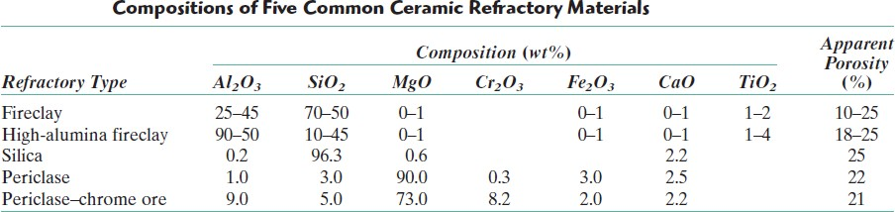
depends on its composition. There are
CERAMIC- FOURTH CLASS
several classifications of commercial
refractories according to the table below:
ABRASIVES
Abrasive ceramics are used to wear,
grind, or cut away other material,

Slide 12
which necessarily is softer. Therefore,
CERAMIC- FOURTH CLASS
the prime need for this group of
materials is hardness or wear
resistance; in addition, a high degree of toughness is essential to ensure that the abrasive particles do not easily fracture. Diamonds, both natural and synthetic (artificial), are utilized as abrasives; however, they are relatively expensive. The more common ceramic

Slide 13
abrasives include silicon
CERAMIC- FOURTH CLASS
carbide,
tungsten carbide (WC),
oxide and silica sand.
aluminum
Abrasives are used in several forms—
bonded to grinding wheels, as coated abrasives. Coated abrasives are those in which an abrasive powder is coated
on some type of paper or cloth material. Wood, metals, ceramics, and

Slide 14
plastics are all frequently ground and
CERAMIC- FOURTH CLASS
polished using this form of abrasive.
For more information and clarification concerning Piezoelectric Ceramics visit https://youtu.be/Ez0GLKh7n24 (Ceramic Abrasive Range)
CEMENTS
Cements are inorganic materials
produced in extremely large quantities. The characteristic feature of these materials is that when mixed
with water, they form a paste that subsequently sets (settle on, does not change its shape) and hardens. Also,

Slide 15
some of these materials act as a
CERAMIC- FOURTH CLASS
bonding phase that chemically binds
particulate aggregates into a single
cohesive structure. The bond of the cement develops at room temperature. Portland cement is the most common type of cements.
One important structure made of cement is concrete. Concrete is a mixture of cement, water, fine

Slide 16
aggregate and coarse aggregate of
CERAMIC- FOURTH CLASS
sands or stones, which hardens to a
stone-like mass.
ADVANCED CERAMICS
Many of our modern technologies
utilize and will continue to utilize
advanced ceramics because of their unique mechanical, chemical, electrical, magnetic, and optical properties and property

Slide 17
combinations. Piezoelectric ceramics
CERAMIC- FOURTH CLASS
is an example of advanced ceramics.
Piezoelectric Ceramics:
A few ceramic materials (as well as
some polymers) exhibit the unusual phenomenon of piezoelectricity1— electric polarization2 (i.e., an electric field or voltage) is generated in the ceramic crystal when a mechanical strain (dimensional change) is imposed on it. The inverse

Slide 18
piezoelectric effect is also displayed by
CERAMIC- FOURTH CLASS
this group of materials; that is, a
mechanical strain results from the
imposition of an electrical field. Piezoelectric materials may be utilized as a converter between electrical and mechanical energies. One of the early uses of piezoelectric ceramics was in sonar, wherein underwater objects (e.g., submarines) are detected and

Slide 19
their positions determined using an
CERAMIC- FOURTH CLASS
ultrasonic emitting and receiving
system. A piezoelectric crystal is
caused to oscillate (fluctuate) by an electrical signal, which produces high- frequency mechanical vibrations that are transmitted through the water. Upon encountering an object, these signals are reflected back, and another piezoelectric material receives this

Slide 20
reflected vibrational energy, which it
CERAMIC- FOURTH CLASS
then converts back into an electrical
signal. Distance from the ultrasonic
source and reflecting body is determined from the gone (passed) time between sending and receiving events.
For more information and clarification concerning Piezoelectric Ceramics visit https://youtu.be/Bxo2TihSrNg (What Is Piezoelectricity: Part 1)

Slide 21
CERAMIC- FOURTH CLASS
General Properties of Ceramic
Ceramics generally have
specific
properties associated with them such as:
Compressive strength: Ceramics are stronger in compression than in tension,
whereas metals have comparable (equivalent) tensile and compressive
strengths. This difference is important when we use ceramic components for
load-bearing applications. It is necessary

Slide 22
to consider the stress distributions in the
CERAMIC- FOURTH CLASS
ceramic to ensure that they are
compressive. An important example is in the design of concrete bridges—the
concrete, a CMC (ceramic matrix ceramic), must be kept in compression.
Ceramics generally have low toughness, although combining them in composites
can dramatically improve this property. Brittleness: This probably comes from personal experiences such as dropping a

Slide 23
glass cup or a plate. The reason that the
CERAMIC- FOURTH CLASS
majority of ceramics are brittle is the
mixed ionic–covalent bonding that holds
the constituent atoms together. At high temperatures (above the glass transition temperature) glass no longer behaves in a brittle manner; it behaves as a viscous liquid. That is why it is easy to form glass into complicated shapes. So, what we can say is that most ceramics are brittle at room temperature but not necessarily at

Slide 24
elevated temperatures. The brittle
CERAMIC- FOURTH CLASS
behaviour of ceramics gives them low
fracture toughness.
Ceramic materials are relatively stiff and strong—stiffness and strength are
comparable (similar) to those of the metals. In addition, ceramics are typically very hard. On the other hand, they are extremely brittle (lack ductility) and are highly vulnerable to fracture.

Slide 25

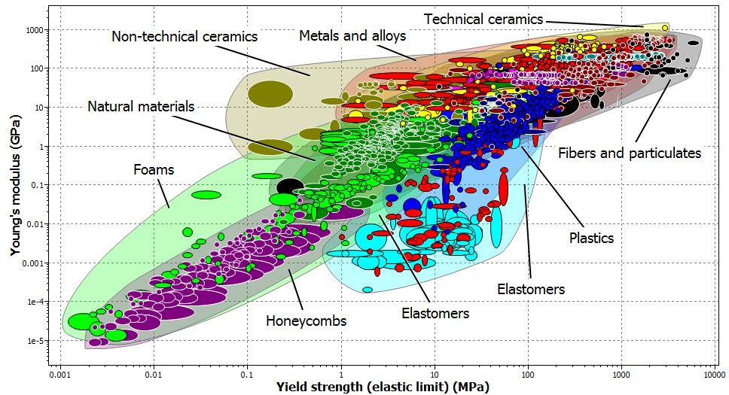

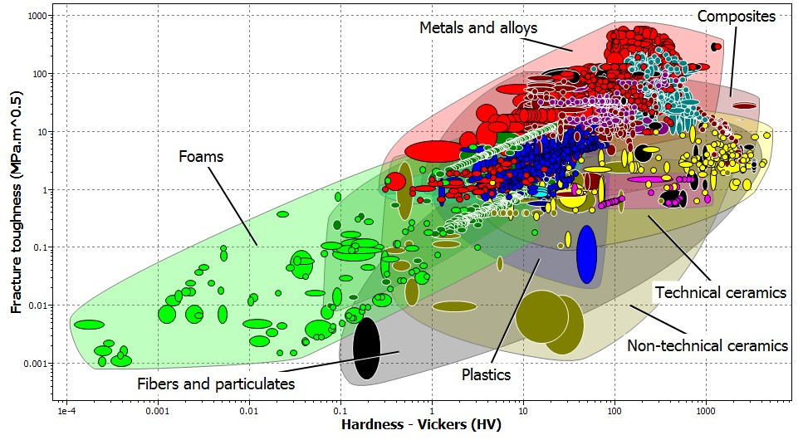
CERAMIC- FOURTH CLASS

Slide 26
Poor electrical and thermal
CERAMIC- FOURTH CLASS
conduction except for Diamond and
the oxide ceramic, ReO3. The valence electrons are tied up in bonds and are not free as they are in metals. In metals, it is the free electrons that determine many of their electrical and thermal properties.

Slide 27

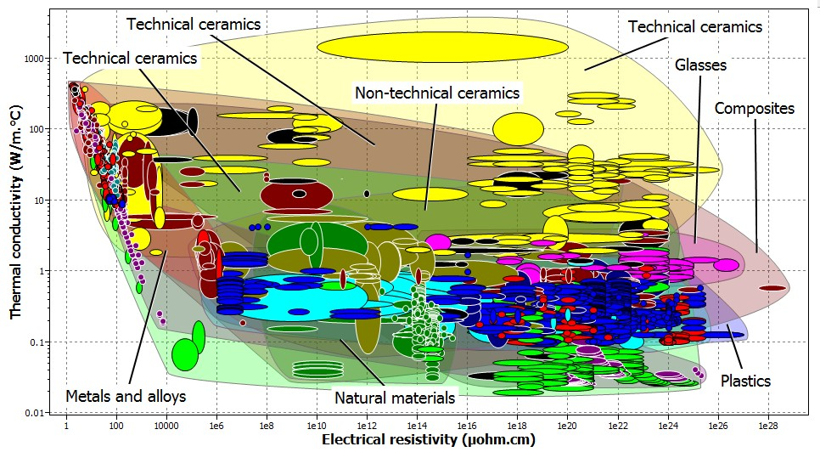
CERAMIC- FOURTH CLASS
Chemical insensitivity: A large
number of ceramics are stable in both harsh chemical and thermal
environments. Pyrex glass is used widely in chemistry laboratories specifically

Slide 28
because it is resistant to many corrosive
CERAMIC- FOURTH CLASS
chemicals, stable at high temperatures (it
does not soften until 1100 K), and is resistant to thermal shock because of its low coefficient of thermal expansion (33
× 10−7 K⁻¹). It is also widely used in bakeware.

Slide 29

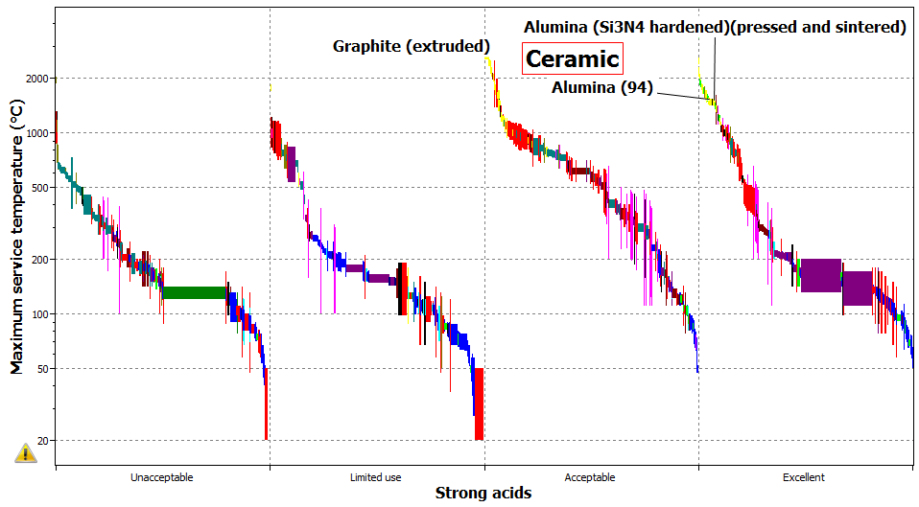
CERAMIC- FOURTH CLASS
So, they are more resistant to high
temperatures and harsh environments than metals and polymers.
Transparency: Many ceramics such as precious stones and optical fibres are

Slide 30
transparent. Metals are transparent to
CERAMIC- FOURTH CLASS
visible light only when they are very thin,
typically less than 0.1 μm. Although it is always possible to find at least one ceramic that shows a typical behaviour, the properties we have mentioned here are in many cases different from those shown by metals and polymers.

Slide 31
CERAMIC- FOURTH CLASS
Fabrication and Processing of Ceramics
One chief concern in the application of
ceramic materials is the method of fabrication.
Many of the metal-forming operations
rely on casting and/or techniques that
involve some form of plastic deformation. Since ceramic materials have relatively high melting temperatures, casting them is normally

Slide 32
impractical. Furthermore, in
CERAMIC- FOURTH CLASS
most
instances the brittleness of these
materials prevents (prohibits) deformation. Some ceramic pieces are formed from powders (or particulate collections) that must ultimately be dried and fired. Glass shapes are formed at elevated temperatures from a fluid mass that becomes very viscous upon cooling. A scheme for the several types of

Slide 33

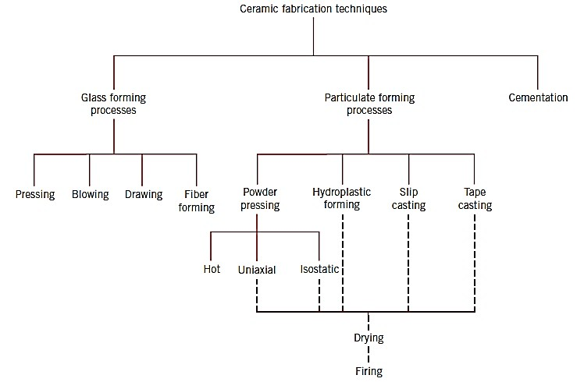
ceramic-forming techniques is presented
CERAMIC- FOURTH CLASS
in Figure 1:
Figure 1: A classification forming techniques.
scheme
for ceramic

Slide 34
FABRICATION AND PROCESSING OF GLASSES AND GLASS–CERAMICS
CERAMIC- FOURTH CLASS
Glass Properties
Before we discuss specific glass-forming
techniques, some of the temperature sensitive properties of glass materials must be presented. Glassy, or noncrystalline, materials do not solidify in the same sense as do those that are crystalline. Upon cooling, a glass becomes more and more viscous in a

Slide 35
continuous manner with decreasing
CERAMIC- FOURTH CLASS
temperature; there is no definite
temperature at which the liquid transforms to a solid as with crystalline materials. In fact, one of the distinctions between crystalline and noncrystalline materials lies in the dependence of specific volume (or volume per unit mass) on temperature, as illustrated in Figure 2.

Slide 36

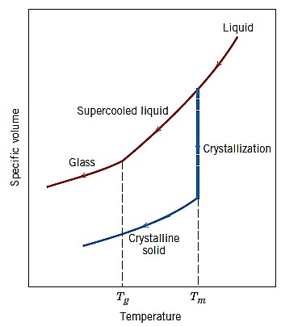
CERAMIC- FOURTH CLASS
Figure 2: Contrast of specific volume versus- temperature behavior of crystalline and noncrystalline materials. Crystalline materials solidify at the melting temperature Tm Characteristic of the noncrystalline state is the glass transition temperature Tg.

Slide 37
For crystalline materials, there is a
CERAMIC- FOURTH CLASS
discontinuous decrease in volume at the
melting temperature Tm. However, for glassy materials, volume decreases continuously with temperature reduction; a slight decrease in slope of the curve occurs at what is called the glass transition temperature, below this temperature, the material is considered to be a glass; above, it is first a super cooled liquid, and finally a liquid.

Slide 38
Also important in glass-forming
CERAMIC- FOURTH CLASS
operations are the viscosity–temperature
characteristics of the glass. Figure 3 plots the logarithm of viscosity versus the temperature for fused silica, high silica, borosilicate, and soda–lime glasses.

Slide 39

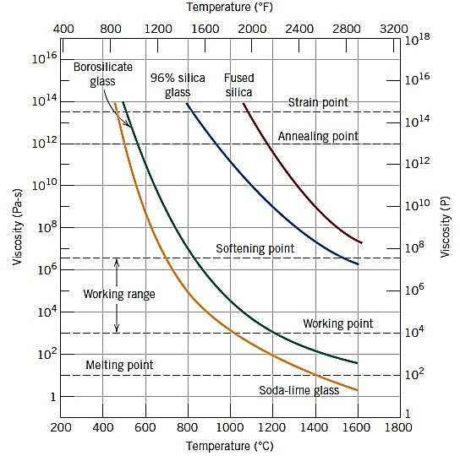
CERAMIC- FOURTH CLASS
Figure 3: Logarithm of viscosity versus temperature for fused silica and three silica glasses.

Slide 40
On the viscosity scale several specific
CERAMIC- FOURTH CLASS
points that are important in the
fabrication and processing of glasses are labeled:
The melting point corresponds to
the temperature at which the viscosity is 10 Pa-s (100 P); the glass is fluid enough to be considered a liquid.
The working point represents the temperature at which the viscosity is 10³

Slide 41
Pa-s (10⁴ P); the glass is easily deformed
CERAMIC- FOURTH CLASS
at this viscosity.
The softening point, the temperature at which the viscosity is 4x 10⁶ Pa-s (4x 10⁷ P), is the maximum temperature at which a glass piece may be handled without causing significant dimensional alterations.
The annealing point is the temperature at which the viscosity is 10¹²
Pa-s (10¹³ P); at this temperature, atomic

Slide 42
diffusion is sufficiently rapid that any
CERAMIC- FOURTH CLASS
residual stresses may be removed within
about 15 min.
5. The strain point corresponds to the temperature at which the viscosity
_{Pa}-s
becomes 3 x 10¹³ (3 x 10¹⁴ P); for
temperatures below the strain point (less
than 450 ⁰C for soda lime glass for example), fracture will occur before the beginning of plastic deformation. The

Slide 43
glass transition temperature
CERAMIC- FOURTH CLASS
will be
above the strain point.
Most glass-forming operations are carried out within the working range— between the working and softening temperatures. Of course, the temperature at which each of these points occurs depends on glass composition. For example, the softening points for soda–lime and 96% silica

Slide 44
glasses from Figure 3 are about 700 and
CERAMIC- FOURTH CLASS
1550 ⁰C, respectively.
That is, forming operations may be carried out at significantly lower temperatures for the soda–lime glass.

Slide 45
CERAMIC- FOURTH CLASS
Glass Forming
Glass is produced by heating the raw
materials to a high temperature above
which melting occurs. Silica is usually supplied as common quartz sand, whereas Na2O and CaO are added as soda ash (Na2CO3) and limestone (CaCO3). For most applications, especially when optical transparency is important, it is essential that the glass

Slide 46
product be homogeneous and pores free.
CERAMIC- FOURTH CLASS
Homogeneity is achieved by complete
melting and mixing of the raw ingredients. Four different forming methods are used to fabricate glass products: pressing, blowing, drawing, and fiber forming.
Pressing is used in the fabrication of relatively thick-walled pieces such as plates and dishes. The glass piece is formed by pressure application in a

Slide 47
graphite-coated cast iron mold having
CERAMIC- FOURTH CLASS
the desired shape; the mold is normally
heated to ensure an even (flat/smooth) surface.
Although some glass blowing is done by
hand, especially for art objects, the process has been completely automated for the production of glass jars (containers), bottles, and light bulbs. The several steps involved in one such technique are illustrated in Figure 1.

Slide 48
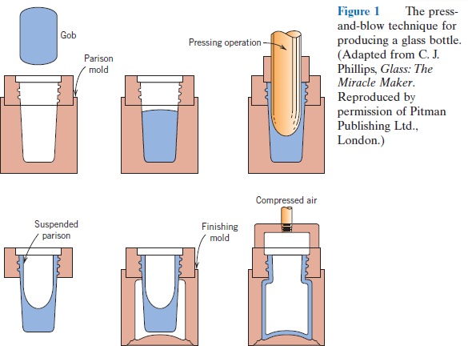
CERAMIC- FOURTH CLASS
A temporary shape is formed by
mechanical pressing in a mold. This piece is inserted into a finishing or blow mold
and forced to fit in the mold contours

Slide 49
(outlines/shape) by the pressure created
CERAMIC- FOURTH CLASS
from a blast of air.
Drawing is used to form long glass pieces such as sheet, rod, tubing, and fibers, which have a constant cross section. Continuous glass fibers are formed in a rather sophisticated drawing operation. The molten glass is placed in a platinum heating chamber (small room). Fibers are formed by drawing the molten glass through many small holes (outlets)

Slide 50

at the chamber base. The glass viscosity,
CERAMIC- FOURTH CLASS
which is critical, is controlled by chamber
and outlets temperatures.
It may also be fabricated by hot rolling. Flatness and the surface finish may be
improved significantly by floating or moving the sheet on a bath of molten tin at an elevated temperature; the piece is slowly cooled and subsequently heat treated by annealing.
For more info visit
glass forming.mp4

Slide 51
CERAMIC- FOURTH CLASS
Heat Treating
of Glasses and glasses
ceramic Annealing
When a ceramic material is cooled from
an elevated temperature, internal
stresses, called thermal stresses, may be
introduced as a result of the difference in cooling rate and thermal contraction between the surface and interior regions. These thermal stresses are important in brittle ceramics, especially glasses, since

Slide 52
they may weaken the material or, in
CERAMIC- FOURTH CLASS
extreme cases, lead to fracture, which is
termed thermal shock. Normally, attempts are made to avoid thermal stresses, which may be accomplished by cooling the piece at a sufficiently slow rate. Once such stresses have been introduced, however, elimination, or at least a reduction in their magnitude, is possible by an annealing heat treatment in which the glass is heated to the

Slide 53
annealing point, then slowly cooled to
CERAMIC- FOURTH CLASS
room temperature.
Glass Tempering
The strength of a glass piece may be
enhanced by intentionally inducing (generating) compressive residual surface stresses. This can be accomplished by a heat treatment procedure called thermal tempering. With this technique, the glassware is heated to a temperature below the

Slide 54
softening point. It is then cooled to room
CERAMIC- FOURTH CLASS
temperature in a stream of air or, in some
cases, an oil bath. The residual stresses arise from differences in cooling rates for surface and interior regions. Initially, the surface cools more rapidly and, once having dropped to a temperature below the strain point, becomes rigid. At this time, the internal parts of the glassware, having cooled less rapidly, is at a higher temperature (above the strain point) and,

Slide 55
therefore, is still plastic. With continued
CERAMIC- FOURTH CLASS
cooling, the interior attempts to contract
to a greater degree than the now rigid exterior will allow. Thus, the inside tends to draw in the outside, or to impose inward radial stresses. As a consequence, after the glass piece has cooled to room temperature, it stands compressive stresses on the surface, with tensile stresses at interior regions. The room- temperature stress distribution over a

Slide 56
cross section of a glass plate is
CERAMIC- FOURTH CLASS
represented schematically in Figure 2.
The failure of ceramic materials almost always results from a crack that is initiated at the surface by an applied tensile stress. To cause fracture of a tempered glass piece, the magnitude of an externally applied tensile stress must be great enough to first overcome the residual compressive surface stress and, in addition, to stress the surface in

Slide 57
tension sufficiently to initiate a crack,
CERAMIC- FOURTH CLASS
which may then propagate. For an
untempered glass, a crack will be introduced at a lower external stress level, and, consequently, the fracture strength will be smaller. Tempered glass is used for applications in which high strength is important; these include large doors and eyeglass lenses.

Slide 58

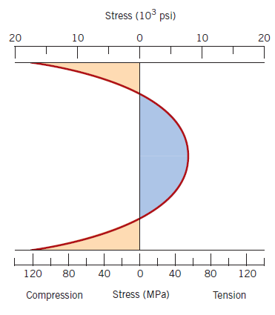
CERAMIC- FOURTH CLASS
Figure 2: Room-temperature residual stress distribution over the cross section of a tempered glass plate.

Slide 59
CERAMIC- FOURTH CLASS
FABRICATION AND PROCESSING OF CLAY PRODUCTS
This class of materials includes the
structural clay products and the
whitewares. In addition to clay (being composed of alumina (Al2O3) and silica (SiO2)), many of these products also contain other ingredients. After having been formed, pieces most often must be subjected to drying and firing operations; each of the ingredients influences the

Slide 60
changes that take place during these
CERAMIC- FOURTH CLASS
processes and the features of the
finished piece.
The as-mined raw materials usually have
to go through a milling or grinding
operation in which particle size is reduced; this is followed by screening or sizing to produce a powdered product having a desired range of particle sizes. For multicomponent systems, powders

Slide 61
must be thoroughly (totally) mixed with
CERAMIC- FOURTH CLASS
water and perhaps other ingredients to
give flow characteristics that are compatible with the particular forming technique. The formed piece must have sufficient mechanical strength to remain intact during transporting, drying, and firing operations. Two common shaping techniques are utilized for forming clay- based compositions: hydroplastic forming and slip casting.

Slide 62
Hydroplastic Forming
CERAMIC- FOURTH CLASS
As mentioned above, clay minerals,
when mixed with water, become highly
plastic and flexible and may be molded without cracking; however, they have extremely low yield strengths. The consistency (water–clay constant ratio) of the hydroplastic mass must give a yield strength sufficient to permit a formed ware to maintain its shape during handling and drying.

Slide 63
The most common hydroplastic forming
CERAMIC- FOURTH CLASS
technique is extrusion, in which a stiff
plastic ceramic mass is forced through a die cavity having the desired cross- sectional geometry; it is similar to the extrusion of metals. Brick, pipe, ceramic blocks, and tiles are all commonly fabricated using hydroplastic forming.
Slip Casting (solid and drain)
Another forming process used for clay-
based compositions is slip casting. A slip

Slide 64
is a suspension of clay and/or other
CERAMIC- FOURTH CLASS
nonplastic materials in water. When
poured into a porous mold, water from the slip is absorbed into the mold, leaving behind a solid layer on the mold wall the thickness of which depends on the time. This process may be continued until the entire mold cavity becomes solid (solid casting). Or it may be finished when the solid shell wall reaches the desired thickness, by inverting the mold and

Slide 65
pouring out the excess slip; this is termed
CERAMIC- FOURTH CLASS
drain casting. As the cast piece dries and
shrinks, it will release from the mold wall; at this time the mold may be disassembled (take to pieces) and the cast piece removed. The nature of the slip is extremely important; it must have a high specific gravity and yet be very fluid and pourable. These characteristics depend on the solid to water ratio and other agents that are added. An

Slide 66
acceptable casting rate is an essential
CERAMIC- FOURTH CLASS
requirement. In addition, the cast piece
must be free of bubbles, and it must have a low drying shrinkage and a relatively high strength.

Slide 67
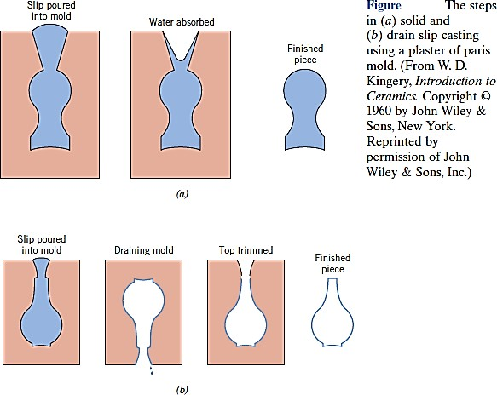
CERAMIC- FOURTH CLASS
The properties of the mold itself influence
the quality of the casting. Normally,
plaster of Paris, which is economical, relatively easy to fabricate into

Slide 68
complicated shapes is used as the mold
CERAMIC- FOURTH CLASS
material. Most molds are multipiece
items that must be assembled before casting. Also, the mold porosity may be diverse to control the casting rate. The relatively complex ceramic shapes that may be produced by means of slip casting include art objects, and specialized scientific laboratory ware such as ceramic tubes.

Slide 69
CERAMIC- FOURTH CLASS
Drying and Firing
A ceramic piece that has been formed
hydroplastically or by slip casting retains significant porosity and insufficient strength for most practical applications. In addition, it may still contain some liquid (e.g., water), which was added to assist in the forming operation. This liquid is removed in a drying process; density

Slide 70
and strength are enhanced as a result
CERAMIC- FOURTH CLASS
of a high-temperature heat treatment
or firing procedure. A body that has
been formed and dried but not fired is termed green. Drying and firing techniques are critical since defects (e.g., distortion, and cracks) may be introduced during the operation. These defects normally result from

Slide 71
stresses that are set up
CERAMIC- FOURTH CLASS
from
nonuniform shrinkage.
Drying
As a clay-based ceramic body dries, it
also experiences some shrinkage. In the early stages of drying the clay particles are virtually surrounded by and separated from one another by a thin film of water. As drying progresses and water is removed, the

Slide 72
interparticle separation decreases,
CERAMIC- FOURTH CLASS
which is revealed as shrinkage.
During drying it is critical to control the
rate of water removal. Drying at interior regions of a body is accomplished by the diffusion (dispersion) of water molecules to the surface where evaporation occurs. If the rate of evaporation is greater than the rate of diffusion, the surface will

Slide 73
dry (and as a consequence shrink)
CERAMIC- FOURTH CLASS
more rapidly than the interior, with a
high probability of the formation of the
above-mentioned defects. The rate of surface evaporation should be diminished to, at most, the rate of water diffusion; evaporation rate may be controlled by temperature, humidity (moisture), and the rate of airflow.

Slide 74
Other factors also influence
shrinkage. One of these is body thickness; nonuniform shrinkage and
CERAMIC- FOURTH CLASS
defect formation are more obvious
(apparent/clearer) in thick pieces than in thin ones. Water content of the formed body is also critical: the greater the water content, the more extensive the shrinkage.

Slide 75
Consequently, the water content is
CERAMIC- FOURTH CLASS
ordinarily kept as low as possible.
Clay particle size also has an
influence; shrinkage is enhanced as the particle size is decreased. To minimize shrinkage, the size of the particles may be increased, or nonplastic materials having relatively large particles may be added to the clay. Microwave energy may also be

Slide 76
used to dry ceramic wares. One
advantage of this technique is that the high temperatures used in conventional methods are avoided; drying temperatures may be kept to
CERAMIC- FOURTH CLASS
below 50 ⁰C. This is important
because the drying of some temperature-sensitive materials should be kept as low as possible.

Slide 77
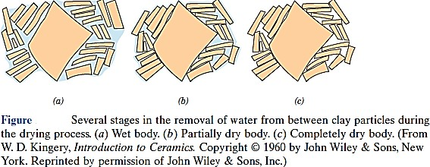
CERAMIC- FOURTH CLASS

Slide 78
CERAMIC- FOURTH CLASS
Firing
After drying, a body is usually fired at a temperature between 900 and 1400 ^{O}C; the firing temperature depends on the composition and desired properties of the finished piece. During the firing operation, the density is further increased (with an attendant

Slide 79
(related) decrease in porosity) and the
CERAMIC- FOURTH CLASS
mechanical strength is enhanced.
When clay-based materials are
heated to elevated temperatures, some rather complex and involved reactions occur. One of these is vitrification, the gradual formation of a liquid glass that flows into and fills some of the pore volume. The degree of vitrification depends on firing

Slide 80
temperature and time, as well as the
composition of the body. The temperature at which the liquid phase
CERAMIC- FOURTH CLASS
forms is lowered by the addition of
fluxing agents such as feldspar. This fused phase flows around the remaining unmelted particles and fills
in the pores as a result of surface tension forces (or capillary action);
shrinkage also accompanies this

Slide 81
process.
CERAMIC- FOURTH CLASS
Upon cooling, this
fused
phase forms a glassy matrix that
results in a dense, strong body. Thus,
the final microstructure consists of the vitrified phase, any unreacted quartz particles, and some porosity. Figure 1 is a scanning electron micrograph of a fired porcelain in which may be seen these microstructural elements.

Slide 82
The degree of vitrification, of course,
controls the room-temperature properties of the ceramic ware; strength, durability, and density are all
CERAMIC- FOURTH CLASS
enhanced as it increases.
The firing temperature determines the extent to which vitrification occurs; that is, vitrification increases as the firing temperature is raised. Building bricks are ordinarily fired around and

Slide 83
are relatively porous. On the other
CERAMIC- FOURTH CLASS
hand, firing of highly vitrified porcelain,
which borders on being optically
translucent, takes place at much higher temperatures. Complete vitrification is avoided during firing, since a body becomes too soft and will collapse.

Slide 84

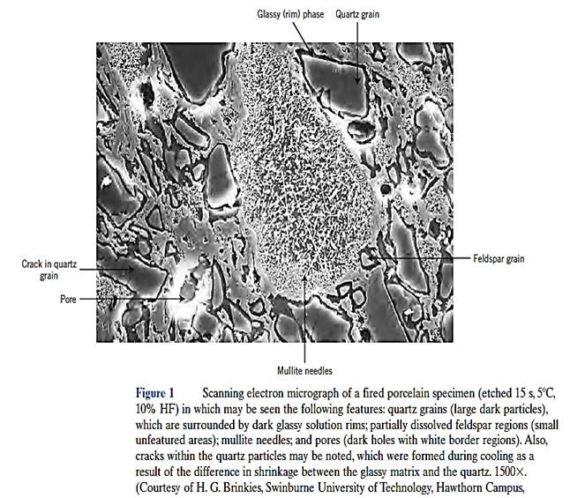
CERAMIC- FOURTH CLASS
POWDER PRESSING
Several ceramic-forming techniques have already been discussed relative

Slide 85
to the fabrication of glass and clay
products. Another important and commonly used method that warrants
CERAMIC- FOURTH CLASS
a brief treatment is powder pressing.
Powder pressing, the ceramic analogue to powder metallurgy, is used to fabricate both clay and
nonclay compositions, including electronic and magnetic ceramics as
well as some refractory brick products.

Slide 86
In essence, a powdered mass, usually
CERAMIC- FOURTH CLASS
containing a small amount of water or
other binder, is compacted into the
desired shape by pressure. The degree of compaction is maximized and fraction of void space is minimized by using coarse and fine particles mixed in appropriate proportions. There is no plastic deformation of the particles during

Slide 87
compaction, as there may be with
CERAMIC- FOURTH CLASS
metal powders. One function of the
binder is to lubricate the powder
particles as they move past one another in the compaction process. There are three basic powder- pressing procedures: uniaxial, isostatic (or hydrostatic), and hot pressing. For uniaxial pressing, the powder is compacted in a metal die by

Slide 88
pressure that is applied in a single
CERAMIC- FOURTH CLASS
direction. The formed piece takes on
the configuration of die and platens
through which the pressure is applied. This method is confined to shapes that are relatively simple; however, production rates are high and the process is inexpensive. The steps involved in one technique are illustrated in the Figure 2:

Slide 89

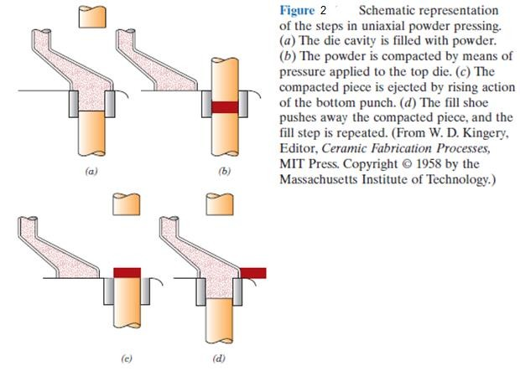
CERAMIC- FOURTH CLASS
For isostatic pressing, the powdered
material is contained in a rubber

Slide 90
envelope and the pressure is applied
CERAMIC- FOURTH CLASS
by a fluid, isostatically (i.e., it has the
same magnitude in all directions).
More complicated shapes are possible than with uniaxial pressing; however, the isostatic technique is more time consuming and expensive. For both uniaxial and isostatic procedures, a firing operation is required after the pressing operation.

Slide 91
During firing the formed piece shrinks,
and experiences a reduction of porosity and an improvement in mechanical integrity. These changes occur by the coalescence of the powder particles into denser mass in
CERAMIC- FOURTH CLASS
a process termed sintering. The
mechanism of sintering is schematically illustrated in Figure 3. After pressing, many of the powder

Slide 92
particles touch one another (Figure
CERAMIC- FOURTH CLASS
3.a). During the initial sintering stage,
necks form along the contact regions
between adjacent particles; in addition, a grain boundary forms within each neck, and every interstice between particles becomes a pore (Figure 3.b). As sintering progresses, the pores become smaller and more spherical in shape (Figure 3.c). A

Slide 93
scanning electron micrograph of a
sintered alumina material is shown in Figure 3. The driving force for sintering is the reduction in total particle surface area; surface energies are larger in magnitude than
CERAMIC- FOURTH CLASS
grain boundary energies.
Sintering is carried out below the melting temperature so that a liquid phase is normally not present. Mass

Slide 94
transport necessary to effect the
changes shown in Figure 3 is accomplished by atomic diffusion from
CERAMIC- FOURTH CLASS
the bulk particles to the neck regions.
With hot pressing, the powder pressing and heat treatment are performed simultaneously— the
powder aggregate is compacted at an elevated temperature. The procedure
is used for materials that do not form

Slide 95
a liquid phase except at very high and
CERAMIC- FOURTH CLASS
impractical temperatures; in addition,
it is utilized when high densities without

Slide 96

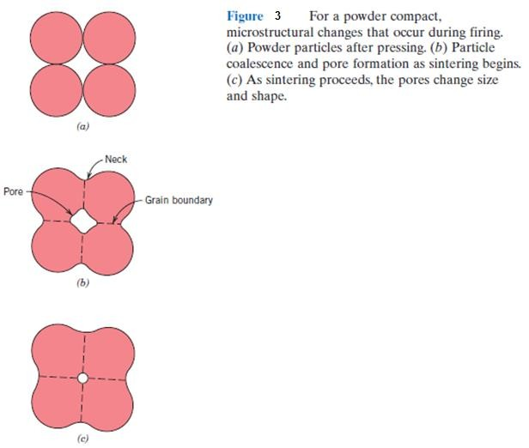
CERAMIC- FOURTH CLASS
appreciable grain growth are desired.
This is an expensive fabrication technique that has some limitations. It

Slide 97
is costly in terms of time, since both
CERAMIC- FOURTH CLASS
mold and die must be heated and
cooled during each cycle. In addition,
the mold is usually expensive to fabricate and ordinarily has a short lifetime.

Slide 98

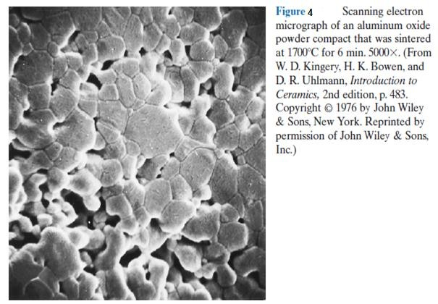

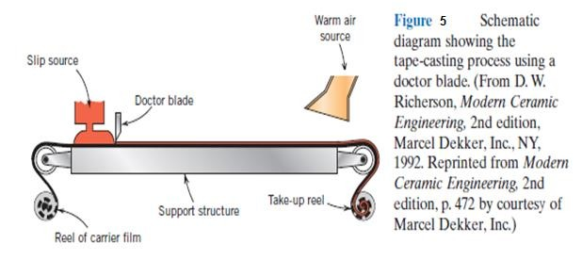
CERAMIC- FOURTH CLASS

Slide 99
TAPE CASTING
An important ceramic fabrication technique, tape casting, will now be
CERAMIC- FOURTH CLASS
briefly discussed.
As the name implies, thin sheets of a flexible tape are produced by means of a casting process. These sheets
are prepared from slips, in many respects similar

Slide 100
to those that are employed for slip
CERAMIC- FOURTH CLASS
casting. This type of slip consists of a
suspension of ceramic particles in an
organic liquid that also contains binders and plasticizers that are incorporated to impart strength and flexibility to the cast tape. De-airing in a vacuum may also be necessary to remove any entrapped air or solvent vapor bubbles, which may act as
100 | P a g e

Slide 101
crack-initiation sites in the finished
CERAMIC- FOURTH CLASS
piece.
The actual tape is formed by pouring
the slip onto a flat surface (of stainless steel, glass, a polymeric film, or paper); a doctor blade spreads the slip into a thin tape of uniform thickness, as shown schematically in Figure
13.18. In the drying process, volatile slip components are removed by
101 | P a g e

Slide 102
evaporation; this green product is a
CERAMIC- FOURTH CLASS
flexible tape that may be cut or into
which holes may be punched prior to a firing operation.
Tape thicknesses normally range
between 0.1 and 2 mm (0.004 to 0.08 in.).
Tape casting is widely used in the production of ceramic substrates that
102 | P a g e

Slide 103
are used for integrated circuits and for
CERAMIC- FOURTH CLASS
multilayered capacitors.
Cementation is also considered to be a ceramic fabrication process.
The cement material, when mixed
with water, forms a paste that, after being fashioned into a desired shape, subsequently hardens as a result of complex chemical reactions.
103 | P a g e

Slide 104
CERAMIC- FOURTH CLASS
SUMMARY
Glasses Glass–Ceramics
These lectures began by discussing the
various types of ceramic materials. The familiar glass materials are noncrystalline silicates that contain other oxides; the most desirable trait of these materials is their optical transparency. Glass–ceramics are initially fabricated as a glass, then crystallized.
104 | P a g e

Slide 105
Clay Products
CERAMIC- FOURTH CLASS
Clay is the principal component of the
whitewares and structural clay products. Other ingredients may be added, such as feldspar and quartz, which influence the changes that occur during firing.
Refractories
The materials that
are employed at
elevated temperatures and often in
reactive environments are the refractory ceramics; on occasion, their ability to
105 | P a g e

Slide 106
thermally insulate is also utilized. On the
CERAMIC- FOURTH CLASS
basis of composition and application, the
four main subdivisions are fireclay, silica, basic, and special.
Abrasives
The abrasive ceramics, being hard and
tough, are utilized to cut, grind, and polish other softer materials. Diamond, silicon carbide, tungsten carbide, corundum, and silica sand are the most common examples. The abrasives may
106 | P a g e

Slide 107
be employed in the form of loose grains,
CERAMIC- FOURTH CLASS
bonded to an abrasive wheel, or coated
on paper or a fabric.
Cements
When mixed with water, inorganic cements form a paste that is capable of
assuming just about any desired shape. Subsequent setting or hardening is a
result of chemical reactions involving the
cement particles and occurs at the ambient temperature.
107 | P a g e

Slide 108
For hydraulic cements, of which Portland
CERAMIC- FOURTH CLASS
cement is the most common, the
chemical reaction is one of hydration.
Advanced Ceramics
Many of our modern technologies utilize and will continue to utilize advanced
ceramics because of their unique mechanical, chemical, electrical,
magnetic, and optical properties and
property combinations. The following advanced ceramic materials were
108 | P a g e

Slide 109
discussed briefly: piezoelectric ceramics,
CERAMIC- FOURTH CLASS
microelectromechanical systems
(MEMS), and ceramic ball bearings. Fabrication and Processing of Glasses and Glass–Ceramics.
The next major section of these lectures
discussed the principal techniques used for the fabrication of ceramic materials. Since glasses are formed at elevated temperatures, the temperature–viscosity behavior is an important consideration.
109 | P a g e

Slide 110
Melting, working, softening, annealing,
CERAMIC- FOURTH CLASS
and strain points represent temperatures
that correspond to specific viscosity values. Knowledge of these points is important in the fabrication and processing of a glass of given composition. Four of the more common glass-forming techniques—pressing, blowing, drawing, and fiber forming— were discussed briefly. After fabrication, glasses may be annealed and/or
110 | P a g e

Slide 111
tempered to improve mechanical
CERAMIC- FOURTH CLASS
characteristics.
Fabrication and Processing of Clay Products
For clay products, two fabrication techniques that are frequently utilized are
hydroplastic forming and slip casting. After forming, a body must be first dried
and then fired at an elevated temperature
to reduce porosity and enhance strength.
111 | P a g e

Slide 112
Shrinkage that is excessive or too rapid
CERAMIC- FOURTH CLASS
may result in cracking and/or warping,
and a worthless piece. Densification during firing is accomplished by vitrification, the formation of a glassy bonding phase.
Powder Pressing
Tape Casting
Some ceramic pieces
powder compaction; isostatic techniques
are formed by
uniaxial and are possible.
112 | P a g e

Slide 113
Densification of pressed pieces takes
CERAMIC- FOURTH CLASS
place by a sintering mechanism during a
high-temperature firing procedure. Hot pressing is also possible in which pressing and sintering operations are carried out simultaneously.
Thin ceramic substrate layers are often fabricated by tape casting.
113 | P a g e

Slide 114
CERAMIC- FOURTH CLASS
QUESTIONS AND PROBLEMS
Glasses Glass–Ceramics
Cite the two desirable characteristics of glasses.
What is crystallization?
Cite two properties that improved by crystallization.
may be
114 | P a g e

Slide 115
Refractories
CERAMIC- FOURTH CLASS
For refractory ceramic materials, cite
three characteristics that improve with and two characteristics that are
adversely affected by increasing porosity.
Cements
Compare the manner in which the aggregate particles become bonded together in clay-based mixtures
115 | P a g e

Slide 116
during firing and in cements during
CERAMIC- FOURTH CLASS
setting.
Fabrication and Processing of
Glasses and Glass–Ceramics
Soda and lime are added to a glass batch in the form of soda ash (Na2CO3) and limestone (CaCO3). During heating, these two ingredients decompose to give off carbon dioxide (CO2), the resulting products being
116 | P a g e

Slide 117
soda and lime. Compute the weight of
CERAMIC- FOURTH CLASS
soda ash and limestone that must be
added to 125 lbm of quartz (SiO2) to yield a glass of composition 78 wt% SiO2, 17 wt% Na2O, and 5 wt% CaO.
What is the distinction between glass
transition temperature and melting temperature?
117 | P a g e

Slide 118
CERAMIC- FOURTH CLASS
Compare the temperatures at which
soda– lime, borosilicate, 96% silica, and fused silica may be annealed.
Compare the softening points for 96%
silica, borosilicate, and soda–lime glasses.
Explain why residual thermal stresses
are introduced into a glass piece when it is cooled.
118 | P a g e

Slide 119
CERAMIC- FOURTH CLASS
Are thermal stresses introduced upon
heating? Why or why not?
Borosilicate glasses and fused silica
are resistant to thermal shock. Why is this so?
In your own words, briefly describe
what happens as a glass piece is thermally tempered.
119 | P a g e

Slide 120
CERAMIC- FOURTH CLASS
Glass pieces may also be
strengthened by chemical tempering. With this procedure, the glass surface
is put in a state of compression by
exchanging some of the cations near the surface with other cations having a larger diameter. Suggest one type of cation that, by replacing Na+, will induce chemical tempering in a soda– lime glass.
120 | P a g e

Slide 121
Fabrication and Processing
CERAMIC- FOURTH CLASS
of Clay
Products
Cite the two desirable characteristics of clay minerals relative to fabrication processes.
From a molecular perspective, briefly
explain the mechanism by which clay
minerals become hydroplastic when water is added.
121 | P a g e

Slide 122
CERAMIC- FOURTH CLASS
What are the three main components
of a whiteware ceramic such as porcelain?
What role does each component play
in the forming and firing procedures?
Why is it so important to control the
rate of drying of a ceramic body that has been hydroplastically formed or
slip cast?
122 | P a g e

Slide 123
CERAMIC- FOURTH CLASS
Cite three factors that influence the
rate of drying, and explain how each affects the rate.
Cite one reason why drying shrinkage
is greater for slip cast or hydroplastic products that have smaller clay particles.
123 | P a g e

Slide 124
CERAMIC- FOURTH CLASS
Name three factors that influence the
degree to which vitrification occurs in claybased ceramic wares.
Explain how density, firing distortion,
strength, corrosion resistance, and thermal conductivity are affected by the extent of vitrification.
124 | P a g e

Slide 125
Powder Pressing
CERAMIC- FOURTH CLASS
Some ceramic materials are
fabricated by hot isostatic pressing. Cite some of the limitations and
difficulties associated with this technique.
DESIGN PROBLEM
Some of our
cookware is
modern
kitchen
made of
ceramic
materials.
125 | P a g e

Slide 126
CERAMIC- FOURTH CLASS
List at least three important
characteristics required of a material to be used for this application.
Make a comparison of three ceramic materials as to their relative properties and, in addition, to cost.
On the basis of this comparison, select the material most suitable for the cookware.
126 | P a g e

